Slide 1
User Property

Slide 2
Modify sakai.properties
Add attribute in sakai.properties file.
Example :
user.additional.attribute.count=3
user.additional.attribute.1=college
user.additional.attribute.2 =room
user.additional.attribute.2 =major
user.additional.attribute.display.college=College
user.additional.attribute.display.room=ROOM
user.additional.attribute.display.major=MAJOR

Slide 3
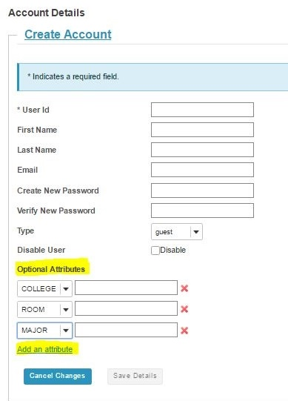
Add/Edit User in Admin
Additional user property can use when add/edit user by admin.
Click “Add an attribute”
Select attribute name to add.

Slide 4
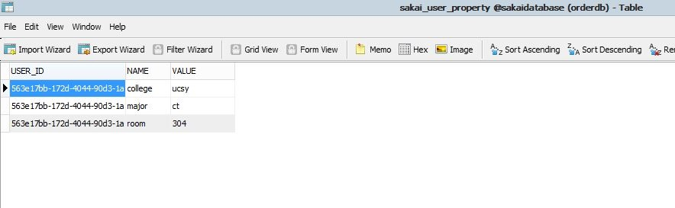
sakai_user_property table
Data is saved in sakai_user_property table.

